Slide 1



Predicting the change in insurance rate post Affordable Care Act - A supervised learning approach
Seán McManus, PhD

Slide 2
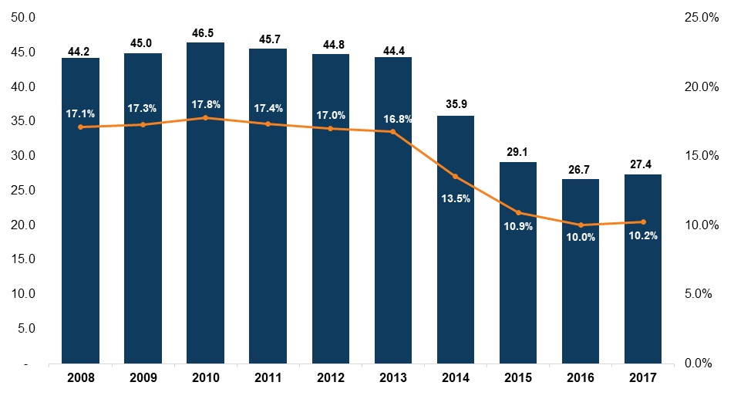
# of uninsured individuals and % uninsured:
Notes:
Decrease of close to 20 million people

Slide 3
Uninsured cancer patients generally have poorer outcomes and are more likely to die prematurely than persons with insurance, largely because of delayed diagnosis. Consistent across a broad range of cancers.
Uninsured adults with chronic diseases are less likely to receive appropriate care to manage their health conditions than are those who have health insurance. Results in higher morbidity and higher mortality.
Uninsured adults with hypertension or high blood cholesterol have diminished access to care, are less likely to be screened, are less likely to take prescription medication if diagnosed, and experience worse health.
Uninsured persons with diabetes are less likely to receive recommended services. Being without health insurance for longer periods increases the risk of inadequate care for this condition and can lead to uncontrolled blood sugar levels, which, over time, put diabetics at risk for additional chronic disease and disability.
Uninsured patients with end-stage renal disease begin dialysis with more severe disease than do those who had insurance before beginning dialysis.
Adults with health insurance that covers any mental health treatment are more likely to receive mental health services and care consistent with clinical practice guidelines.
Uninsured patients with acute cardiovascular disease are less likely to be admitted to a hospital that performs angiography or revascularization procedures, and are more likely to die in the short term.
Longitudinal population-based studies of the mortality of uninsured and privately insured adults reveal a higher risk of dying prematurely for those who were uninsured at the beginning of the study than for those who initially had private coverage.

Slide 4

A moral issue….

Slide 5

A fiscal responsibility issue….

Slide 6

The hidden risks….
Contagian of disease
Loss of productivity and contribution to the economy by the worker
Loss of productivity and contribution to the economy due to extra family care required
The money spent on medicaid expansion has had a multiplier effect estimated at 1.5 to 2 times the investment.
In other words, the money invested in decreasing the percentage of individuals uninsured, is effectively a money maker.
[1]

Slide 7
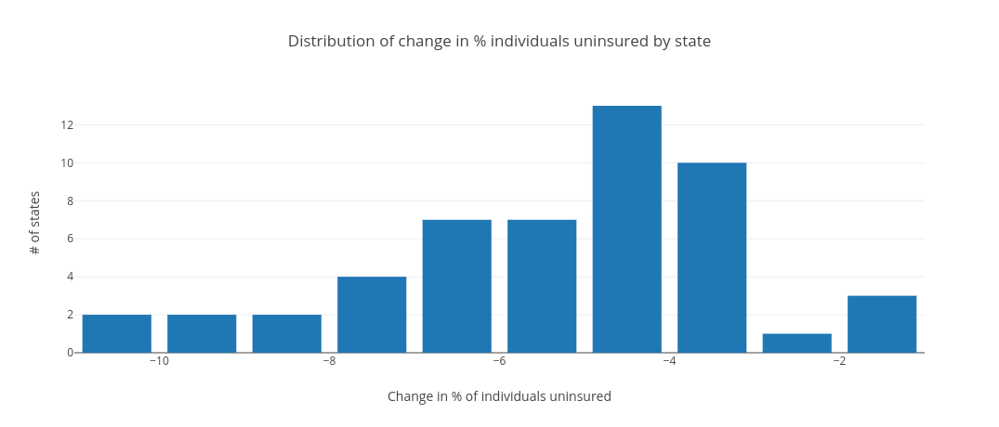
The problem:
The ACA lead to 20 million people gaining insurance, but the effect of this piece of legislation varied greatly by state.

Slide 8
The question(s):
Can we accurately predict the effect size of the ACA , as measured by change in % individuals uninsured, by feature variables that describe that state?
Can we establish the metrics that have the biggest effect on the change in % individuals uninsured?
The benefits:
Objective benefits:
Potential to inform strategically crafted legislation that maximizes effect size.
Non-objective benefits:
Of major political capital.

Slide 9
The data:
Personally collated data set from data provided by
Department of Health and Human Services
and
The Henry J Kaiser Family Foundation

Slide 10
The data - described:
Target feature:
Dataframe shape: 52 samples/rows and 34 features
Significant feature engineering and subsequent feature selection
Significant sample size problems
No missing data

Slide 11
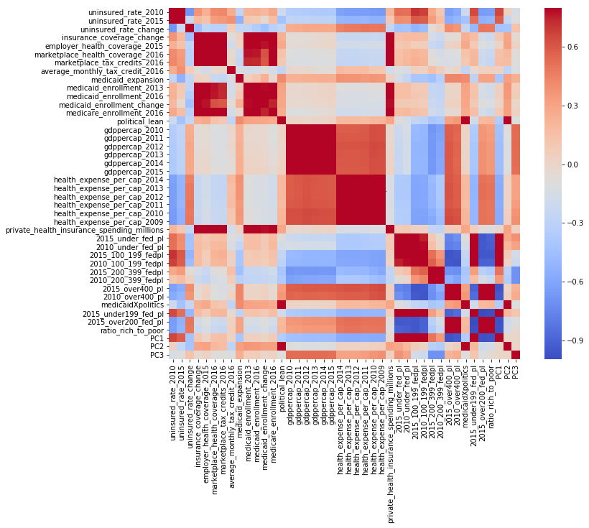
Lot’s of descriptive
value in the features, perhaps not enough samples..

Slide 12
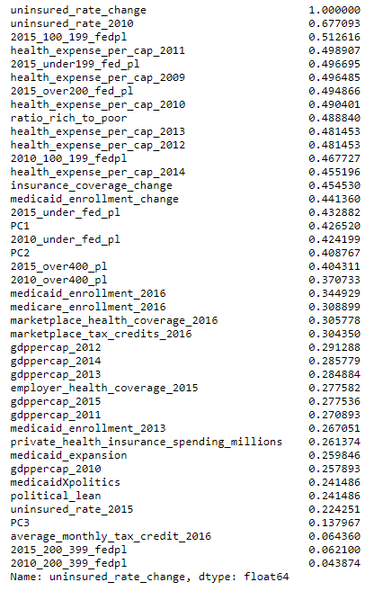
First task: reduce variables
Tried PCA to compress effect of politics and levels of poverty into 1 or 2 variables - ultimately didn’t include.
Process of elimination led to selection of the following:
Health Expense Per Cap 2012 (wanted 2010 data but was unavailable)
Ratio of individuals over 200% federal poverty line (FPL) to individuals under 200% of FPL
Uninsured Rate 2010
Politcal Lean
Medicaid Expansion Status

Slide 13
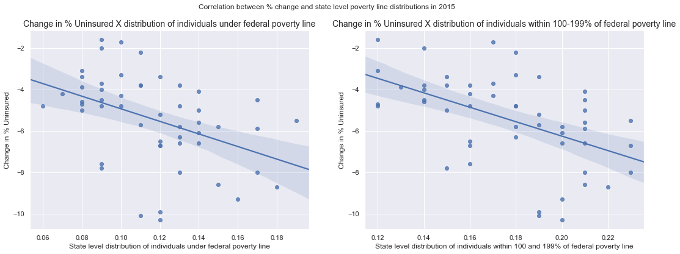
Exploration - effect of poverty levels:

Slide 14
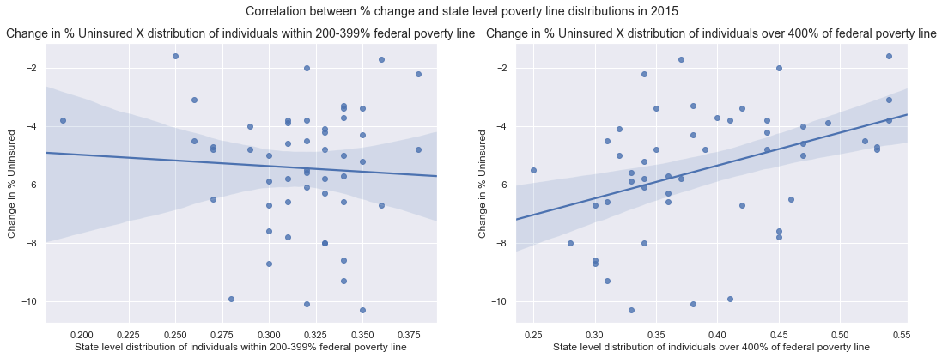
Exploration - effect of poverty levels:

Slide 15
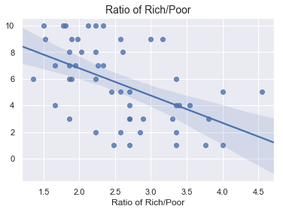
Feature ratio of ‘Rich’ to ‘Poor’ gave best balance of descriptive value and dimensionality.

Slide 16
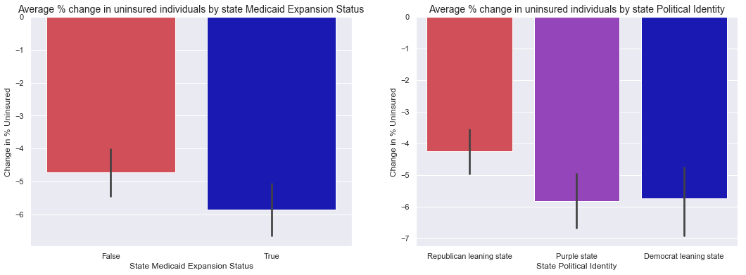
Exploration - Medicaid Expansion X State politics interaction (Pt I)

Slide 17
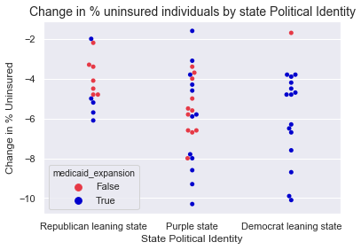
Exploration - Medicaid Expansion X State politics interaction (Pt II)

Slide 18
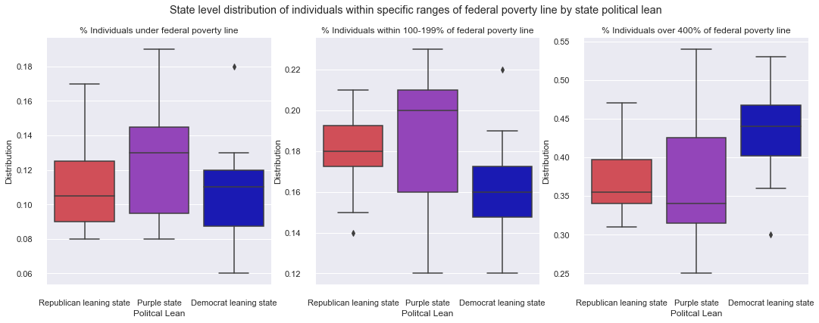
What about when we account for poverty level?

Slide 19
Suggest economics and medicaid expansion offer bulk of predictive power, but political lean offers the final part of the recipe.

Slide 20
Should we include state politics as a feature variable?
This requires justification - they should only be added if the add predictive value. Not to support a partisan stand point.
Variables added significant predictivity accuracy to my models that could not be replicated with other variables.
Low correlation with other features of the dataset.
TLDR: Politcal lean had an effect that couldn’t be replicated by inclusion of other variables.

Slide 21
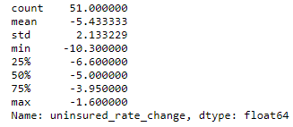
Any issues with our outcome variable?
Slight negative skew.
Otherwise relatively normally distributed.
Data not transformed or modified to preserve integrity of investigation where possible.

Slide 22
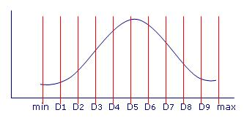
Some models aren’t suited to regression…
Can I make this a classification problem if needed?
Some supervised learning models cannot be adopted towards regression. As an option, I also encoded the data in categories depending on their decile.
Downside of this approach:
Loss of resolution could mean artificially higher score metrics for these models.

Slide 23
The models:
Initial approach:
Initial models utilized all variables
Not efficient, or productive
Subsequent models focussed on my selected variables
Predictive accuracy increased, as to be expected

Slide 24
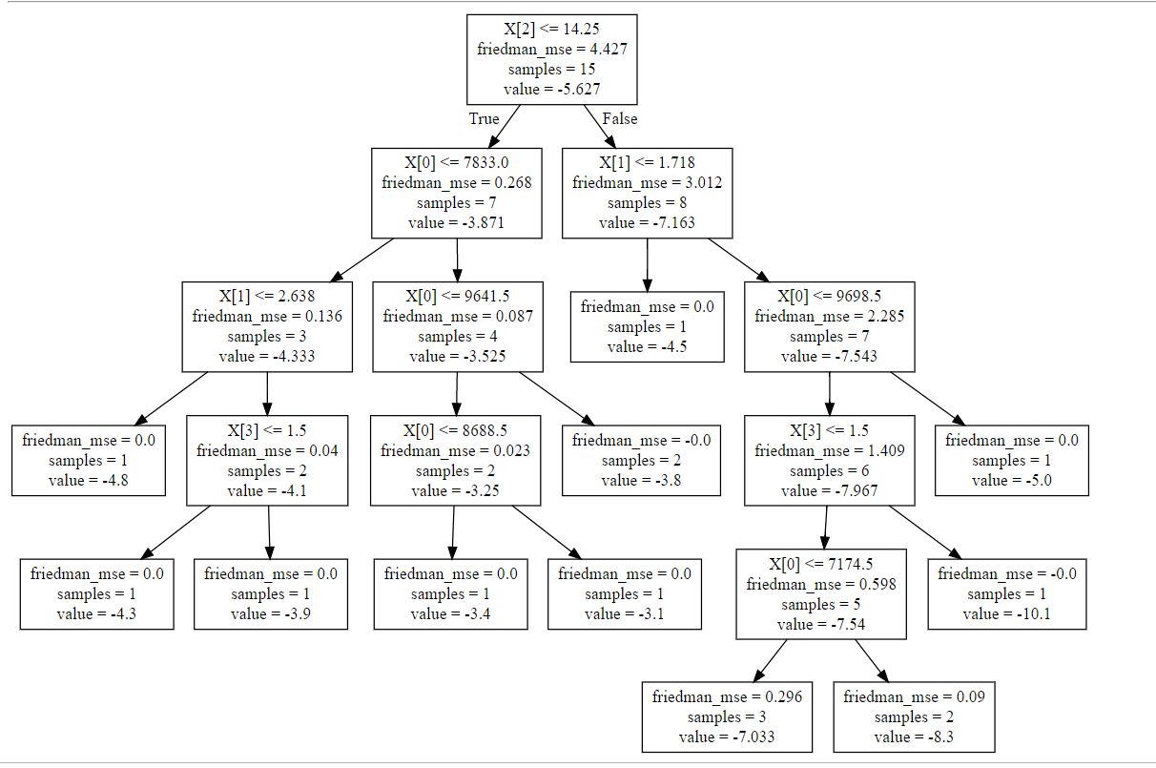
The models - Decision tree regressor:
Decision Trees:
Tried as a classification problem with deciles, not productive. Best score was 0.25
Ran as a regressor with following settings:
Criterion=Friedman MSE Max features=3 Max depth=5 Splitter = best
Optimizes decision tree splits based on Friedmann improvement score on MSE.
In this context, there’s a problem with this.

Slide 25
The models - Decision tree regressor:
Decision Trees:
Regressor with following settings:
Criterion=Friedman MSE Max features=3 Max depth=5 Splitter = best
It’s easy for the computer to get the MSE down and fit the data with this improvement score. We only have 52 samples.
It’s not a generlizable model though.
Results: Training R² = 0.999 Test R² = -0.114 Completely overfit

Slide 26
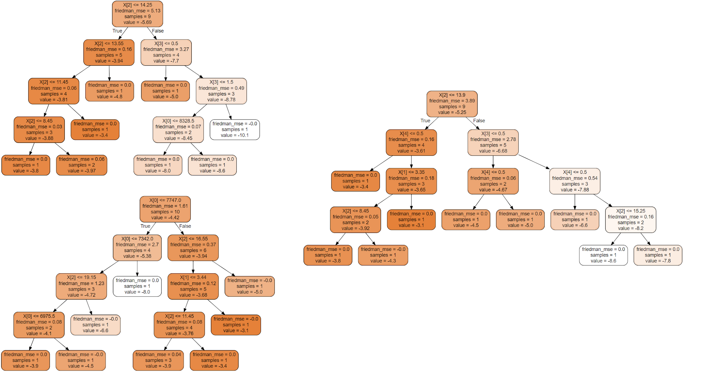
The models - Random Forest:
Some of trees from my forest.
Grid Search CV yielded similar parameters:
Criterion=Friedman MSE Max features=2 Max depth=4 # of estimators =20
Results: Training R² = 0.638 Test R² = 0.525 Not a terrible model - but not still not great

Slide 27
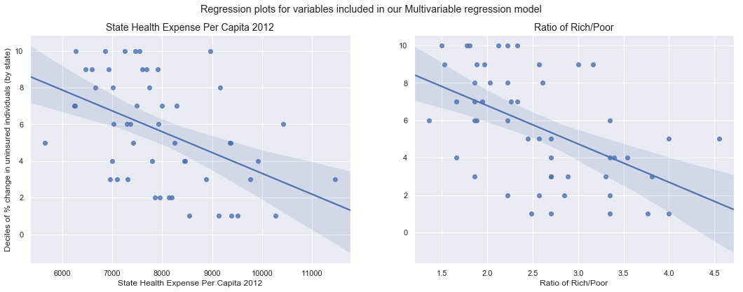
The models - Multivariable Linear Regression:
Sometimes simplest is the best:
Results: Training R² = 0.758 Test R² = 0.702 A good model

Slide 28
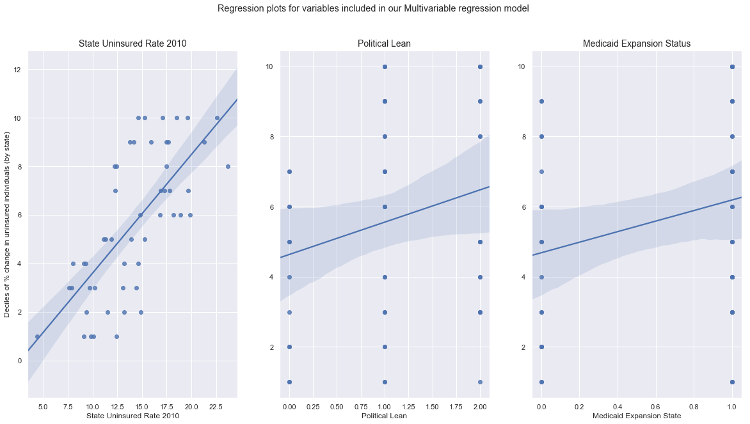
The models - Multivariable Linear Regression:
Sometimes simplest is the best:
Results: Training R² = 0.758 Test R² = 0.702 A good model

Slide 29
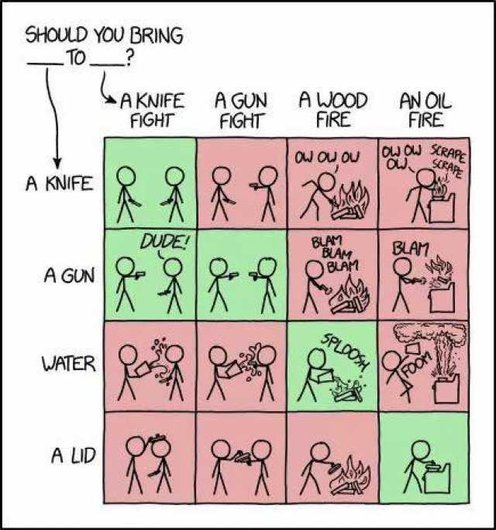
The models - Gradient Boost Regression
Grid Search CV yielded the following parameters: Learning rate=0.2 loss=ls Max features=4 # of estimators =8
Results: Training R² = 0.674 Test R² = 0.30 Basically same as RF regression
‘Bringing a gun to a knife fight’

Slide 30
The models - Gradient Boost Regression
Grid Search CV yielded the following parameters: Learning rate=0.2 loss=ls Max features=4 # of estimators =8
Results: Training R² = 0.674 Test R² = 0.30 Basically same as RF regression
‘Bringing a gun to a knife fight’

Slide 31
The models - Gradient Boost Regression
Advantages of boosting methods with linear regression: -Helping in the case of overfitting.
-When data is of some non linear complex shape. Boosting allows model to slowly evolve to fit data.
Gradient Boost Regression results: Training R² = 0.674 Test R² = 0.30 Not a good model
Vanilla Multivariate Linear Regression results: Training R² = 0.758 Test R² = 0.702 A good model

Slide 32
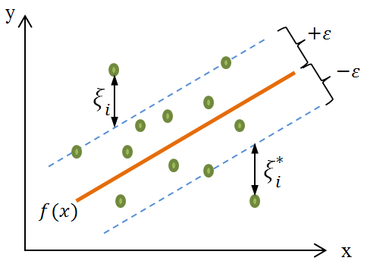
The models - Support Vector Machines
Grid Search CV crashed my kernel, so parameters were tested individually:
C: No impact from changing Episilon: No impact from changing Kernel: RBF or Linear worked equally (poorly)
Support Vector Machines results: Training R² = 0.445 Test R² = 0.608 Underfit - model may be biased towards positive end of tail

Slide 33
The models - my pick:
The multivariable linear regression model has high predictive accuracy AND seems to be generalizable.
Model was not over OR underfit.

Slide 34
What we learned...:
Real world impact:
We can fairly accurately estimate what states *should have had a high impact from the ACA.
We have a better idea what variables effect legislation like the ACA.
Predictive quality of analysis could be used to craft state specific legislation to reduce effect of externalities on both economic outcomes and human quality of life.
Interested party’s could use this information how they choose.

Slide 35
What we learned...:
My own learning:
- Start with simpler models and then build up - Start with fewer higher impact variables and then build up not vice versa. - Sometimes complex problems have simple answers - you just need to know how to look for them

Slide 36
Thank you:
Dr. David Reed, My mentor
, Reviewer
, The audience

Slide 37
References
https://www.healthaffairs.org/do/10.1377/hblog20160321.054035/full/

